Slide 1
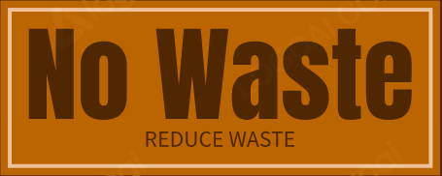
No Waste
Pitch Presentation for Appdev && Event Driver Programming
Conwell Maraya BSCS-2

Slide 2
What is it:
An Application designed to help you reduce your food waste.
What can it Do:
Track your current stock of food
Remind you to consume food that’s close to expiring
Keep track of what you forget to consume most often

Slide 3
Features & Benefits
Pantry Storage System to represent all your food items
Automated Deletion of Food items if they go over their set expiry Date
Toast Notifications for food that’s close to being expired

Slide 4
Project Scope
Must be Developed in 3 Months or less
Must have Storage Capabilities
Must be deployable as a standalone application

Slide 5
User and Functional Requirements
The Ability to View Food Items in the Grid
The Ability to Add Food Items into the Grid
Food Items Must Contain a Name, and an Expiration Date
If user does not add an expiration date, the program will automatically assign it to have an expiration date matching the current date plus one day
Food Items will be listed in the format of (Name : Expiration Date). And will be sorted by their expiration date in ascending order

Slide 6
User and Functional Requirements
Automatic Deletion of Expired Food Items and Notification System
The Ability to Remove Food Items from the Grid
Clicking a Food Item in the Grid will display a window that lets the user mark the food as Consumed or Disposed. Choosing either option removes the item from the grid and makes a note of it in a file.
Food Items whose expiration dates passed while the program was closed will, on the program being started up, be automatically removed from the grid and a message will display showing what was deleted
If any item is close to their expiration date, the user will be notified via a toast notification on their device

Slide 7
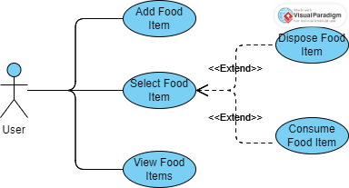
Use Case Diagram:

Slide 8




Technologies Used:
Editors:
Frameworks:
Languages:

Slide 9
Demonstration of the App

Slide 10
Thank you For your Time.

